Slide 1
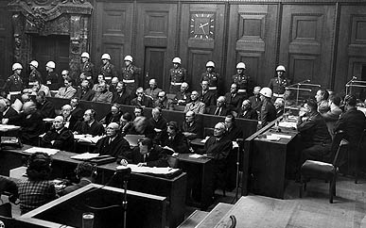
Nuremberg Trials
Prof. Thaddeus Hoffmeister
thoffmeister1@udayton.edu

Slide 2
Nuremberg Trials
“Greatest trial in history”
“Victor’s Justice”
3 ways to teach the Nuremberg Trials
Trial Practice
Criminal Law
International Law

Slide 3
Road Map
WW II and Alternatives to Nuremberg
London Charter and Set-Up of the IMT
Defendants and Counts
Defenses and Verdict
Legacy of the IMT and Additional Resources

Slide 4
W.W. II
Deadliest conflict in human history
100 million people serving in military units
50-70 million fatalities
What do you do with those responsible for causing the war?

Slide 5
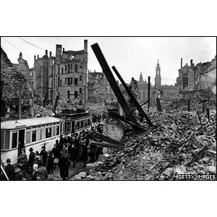
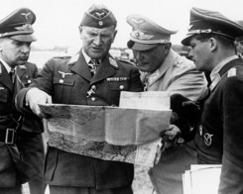
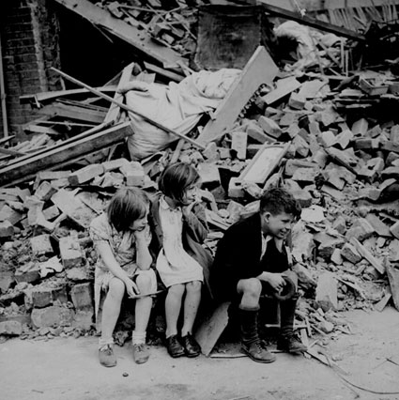
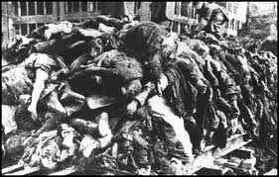

Slide 6
Alternatives to Nuremberg
Do nothing
Summary executions (British)
Individual trials in respective countries
Military court-martial
Tried locally
Show trial (Soviets)

Slide 7
Show Trials
Elements of a show trial
Increased probability of the D’s conviction resulting from the planning and control of the trial
Courtroom: Inside vs. Outside

Slide 8
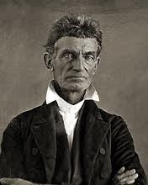
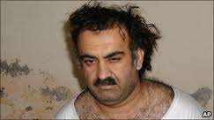
Show Trials

Slide 9
London Charter
Created by the Allies (French, British, American and Soviets) on August 8, 1945
Set the laws and procedures for the Nuremberg Trials
Established the crimes by which to charge the Defendants
No Allies prosecuted only Germans
Same folks who set up the Charter prosecuted the cases

Slide 10
London Charter
Not operating in a vacuum
Lieber Code used during the U.S. Civil War. It detailed how civilians, POWs and spies should be treated. Other countries had similar codes
Hague Convention focusing on the rights of civilians and captured soldiers
Geneva Convention I-III establishing the standard for treating the wounded and POWs

Slide 11
Set Up of the IMT
Civil and common law hybrid
Civil Law
No jury (judges from the Allied nations)
Common Law
X-examination
Defendants decide whether to testify

Slide 12
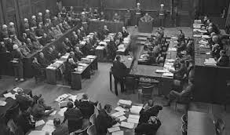
Set Up of the IMT

Slide 13
Set-Up of the IMT
Limited discovery
No real appeal just clemency to the Allied Control Council
No real rules of evidence
Hearsay and Ex Parte affidavits
Allowed trial in absentia

Slide 14
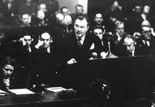
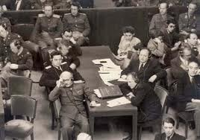
Allied Attorneys

Slide 15
Allied Attorneys: Justice Jackson
Chief Prosecutor for the U.S.
Would you use a Supreme Court justice to prosecute a case? Why or why not?
Closing Argument
X-Examination

Slide 16
24 German Defendants
Politicians
Military Leaders
Civilians
Organizations (SS, Reich Cabinet, General Staff and High Command)

Slide 17
Defendants

Slide 18
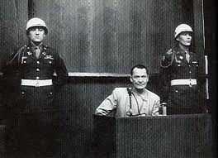
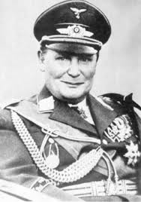
Defendants

Slide 19
4 Counts: Count #2
Crimes Against Peace (Aggressive War)
Planning, preparing or initiating a war of aggression
This was the focus of the trial
What is Aggressive War?
How is it different from Passive War?

Slide 20
4 Counts: Count #2
No historical precedent for charging Aggressive War
Has not been used since Nuremberg
International community struggles to define Aggressive War
Does the Aggressive War count take away from the other charges?

Slide 21
4 Counts: Count #3
War Crimes
Breaking the rules of war.
Slave labor, bombing civilian populations, killing POWs, destroying civilian homes and property
Strong historical precedent
Similar to traditional crimes but these occur on the battlefield
Still used today

Slide 22
4 Counts: Count #4
Crimes Against Humanity
The murder, extermination, enslavement, deportation, and other inhumane acts committed against any civilian population before or during the war
What most people think of when you say Nuremberg Trials
Crimes universally accepted as wrong
Used international law not a national statute

Slide 23
4 Counts: Count #I
Conspiracy
Leaders, organizers, instigators, and accomplices in the formulation or execution of a common plan, or a conspiracy to commit any of the following crimes by any persons in executing such a plan
Crimes Against Peace (Aggressive War)
War Crimes
Crimes Against Humanity

Slide 24
4 Counts: Count #I
Elements of Conspiracy
Agreement to commit an illegal act
Overt Act
The Importance of Conspiracy
Reach prewar activities
Reach individuals who were not actually trigger pullers
Have one big trial

Slide 25
4 Counts: Count I Conspiracy
Common Law concept
Not recognized in other countries
May not become Customary Law

Slide 26
Defenses
“I was not there”
Jurisdiction
Disallowed pursuant to Article 3 of the London Charter
Tu Quoque (“You, Too”)

Slide 27
Defenses
Superior Orders
Used for mitigation but not as an outright defense (Article 8)
Führerprinzip (the Führer's word is above all written law)
Ex Post Facto
A law passed after the occurrence of a fact

Slide 28
Verdict
3 acquitted, 7 prison terms, 11 hanged
Ex Post Facto:
(1) Prior treaties banning countries from waging Aggressive War
(2) Hague Treaty which prohibits Law of War violations doesn’t specifically name individuals but individuals are covered
Customary international law of war results from consistent practice of states followed by them from a sense of legal obligation.

Slide 29
Verdict
Conspiracy
Strict Interpretation by the Court
Only applicable to Aggressive War (not applied to war crimes or crimes against humanity)
Only prewar activities you can reach are those related to waging an Aggressive War

Slide 30
Legacy of Nuremberg
Senator Taft (1946)
I question whether the hanging of those, who, however despicable, were the leaders of the German people, will ever discourage the making of aggressive war, for no one makes aggressive war unless he expects to win. About this whole judgment there is the spirit of vengeance, and vengeance is seldom justice. The hanging of the eleven men convicted will be a blot on the American record which we shall long regret.

Slide 31
Legacy of Nuremberg
Supreme Court Justice William O. Douglass
No matter how finely the lawyers analyzed it, the crime for which the Nazis were tried had never been formalized as a crime with the definiteness required by our legal standards, nor outlawed with a death penalty by the international community. By our standards that crime arose under an ex post facto law. Goering et al. deserved severe punishment. But their guilt did not justify us in substituting power for principal.

Slide 32
Legacy of Nuremberg
Demise of national sovereignty
Universal jurisdiction (Eichmann case)
Domestic activities now part of international law
Protect individuals when the state fails to act
Individual criminal responsibility
Official positions provide no immunity (Article 7)
Can’t avoid responsibility by saying you were just following orders

Slide 33
Legacy of Nuremberg
ICTY
Neutral judges
Ad hoc
Created by UN Security Council
Jurisdiction clearly based on customary international law
Separate Court of Appeal

Slide 34
Legacy of Nuremberg
ICC
Past and future events
Limits ex post facto (Treaty of Rome)
Sovereignty less of an issue because nations participate in the drafting
Evidentiary rules
Prosecutor not subject to the control of the UN
Countries may not want to participate in international activities
Won’t prosecute if local country sufficiently prosecutes

Slide 35
Legacy of Nuremberg
Act of Aggression as defined by the ICC (2010)
The use of armed force by one State against another State without the justification of self-defense or authorization by the Security Council. The definition of the act of aggression, as well as the actions qualifying as acts of aggression contained in the amendments (for example invasion by armed forces, bombardment and blockade), are influenced by the UN General Assembly Resolution 3314 (XXIX) of 14 December 1974. (Still has to be adopted by ICC State parties)

Slide 36
Additional Resources
Telford Taylor, The Anatomy of the Nuremberg Trials (1992)
Christian Tomuschat, The Legacy of Nuremberg, 4 J. Int’l Crim. Just. 830 (2006)
Avalon Project

